Slide 1


1
24AIM112 - MOLECULAR BIOLOGY AND BASIC CELLULAR PHYSIOLOGY
24AIM115 - ETHICS, INNOVATIVE RESEARCH AND IPR
GENE CO-EXPRESSION NETWORK ANALYSIS
PRESENTED BY TEAM 11:
MINOTI K - CB.AI.U4AIM24130
NIVEDHITHA S - CB.AI.U4AIM24134
JAISON JOHN SAMUEL J - CB.AI.U4AIM24116
SANCHITA B - CB.AI.U4AIM24141
FACULTY INCHARGE:
KELATH MURALI MANOJ
MRS. RESHMA SANAL
NEELESH ASHOK

Slide 2
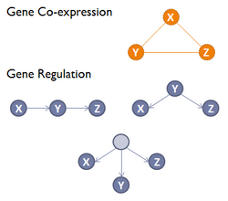
INTRODUCTION
2
Diseases are driven by disruptions in intricate gene-gene interactions rather than isolated gene mutations.
Gene Co-expression Network Analysis (GCNA) is a powerful computational approach to explore complex relationships between genes.
Dataset - The project utilizes a dataset from NCBI - Systems biological assessment of immunity to severe and mild COVID-19 infection (GSE152418)
The project utilizes ethical and innovative approach to analyze gene co-expression networks.

Slide 3



3
OBJECTIVES
To identify gene modules (clusters), hub genes etc., of highly expressed genes with the dataset.
Perform Enrichment analysis of the identified gene modules and integration of AI with the same
Compare the gene expression network with other similar disease to get a broader understanding
Analyze the ethical concerns on gene analysis, intellectual property rights and propose solutions for the same

Slide 4
LITERATURE REVIEW
4
S.No | TITLE OF THE PAPER | YEAR OF RELEASE | INFERENCE AND FINDINGS OF THE PAPER
1 | Weighted Gene Co-Expression Network Analysis to Identify Potential Biological Processes and Key Genes in Covid-19-Related Stroke | 2022 | The paper utilizes two dataset from GEO database of NCBI. GO (Gene Ontology) and KEGG (Kyoto Encyclopedia of Genes and Genomes) were used for enrichment analysis. Top 5 genes were screened as hub genes after visualizing it through hub genes. By intersecting stroke and COVID-19 related stroke, 28 common genes were found.
2 | Differential Co-Expression Network Analysis Reveals Key Hub-High Traffic Genes as Potential Therapeutic Targets for COVID-19 Pandemic | 2021 | RNA-seq data from peripheral blood mononuclear cells of healthy, mid and server 17 COVID - 19 patients were analyzed. WGCNA analyzed co-expression modules. The differential network analysis, module preservation and module-trait relationships approaches were new.

Slide 5
5
LITERATURE REVIEW
S.No | TITLE OF THE PAPER | YEAR OF RELEASE | INFERENCE AND FINDINGS OF THE PAPER
3 | Weighted Gene Co-expression Network Analysis Combined with Machine Learning Validation to Identify Key Modules and Hub Genes Associated with SARS-Co-V-2 Infection | 2021 | The weighted co-expression network analysis and LIME as an explainable AI algorithm to the characterize transcriptional changed in bronchial epithelium cells. The studied detected that it was significantly correlated to pathogenicity of COVID-19 infection based identified hub genes. The enrichment analysis of hub genes using KEGG was also done.
4 | Drug repurposing for coronavirus (SARS-CoC-2) based on gene co-expression network analysis | 2021 | The gene co-expression network was constructed for 1441 genes. 2 genes modules were discovered as significant modules. miRNAs and transcription factors were gathered and made as sub-networks. The drug were taken from DGIDb database and potential two drug-gene and drug-TF were reconstructed. The paper finally proposed 5 drugs for the same.

Slide 6

6
RESEARCH GAP
Most of the CGNA studies focused on protein-coding genes and ignored long non-coding RNAs
Evolutionary CGNA can be performed - how past pandemics human immune gene networks
No major study on how SARS-CoV-2 infection brain-specific co-gene modules

Slide 7
7
WHAT ARE WE PLANNING TO DO?
TO MAKE COEXPRESSION NETWORK TO ANALYZE GENE MODULES, HUB GENES etc.,
TO FURTHER PERFORM ENRICHMENT ANALYSIS FOR THE SAME.
TO UNDERSTAND ETHICAL ASPECTS, IPR AND PATENT RIGHTS RELATED TO THE PROJECT
COMPARE THE COEXPRESSION NETWORK WITH OTHER SIMILAR DISEASE TO GET A BROAD OVERVIEW ABOUT THE SAME

Slide 8
METHODOLOGY
8
MOLECULAR BIOLOGY AND BASIC CELLULAR PHYSIOLOGY
Expression data downloaded from NCBI website and metadata (or phenotypic data) taken directly from GEO website.
Both the data merged
Performed quality control - checked for outliers using goodSamplegenes package, hierarchical clustering, principal component analysis.
Dendrogram from hierarchical clustering and PCA technique compared and outliers removed from data.
Created dds data with raw counts for DESeq2 - used to normalize the data
WGCNA network constructed
A module with eigengenes were made to summarize whole module expression and correlated with modules as well.
Binarized the found modules with traits (disease metadata)

Slide 9
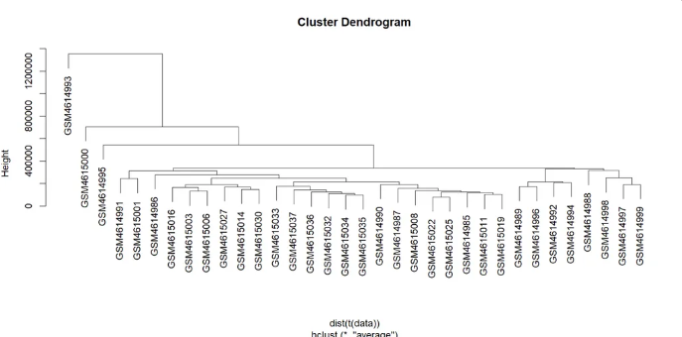
RESULTS
9
MOLECULAR BIOLOGY AND BASIC CELLULAR PHYSIOLOGY
CLUSTER DENDROGRAM FROM HIERARCHICAL CLUSTERING

Slide 10
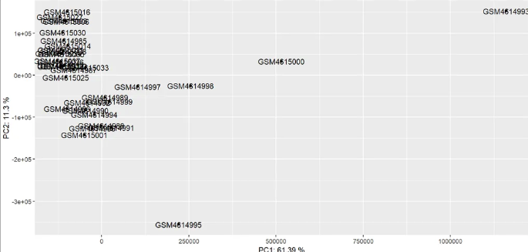
RESULTS
10
MOLECULAR BIOLOGY AND BASIC CELLULAR PHYSIOLOGY
GRAPH FROM PRINCIPLE COMPONENT ANALYSIS

Slide 11
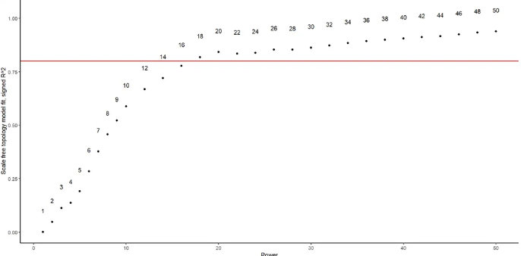
RESULTS
11
MOLECULAR BIOLOGY AND BASIC CELLULAR PHYSIOLOGY
GRAPH USED TO PICK SOFT THRESHOLD

Slide 12
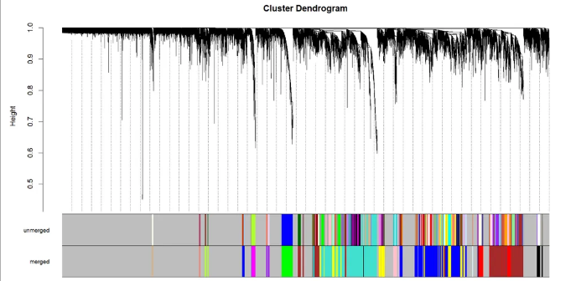
RESULTS
12
MOLECULAR BIOLOGY AND BASIC CELLULAR PHYSIOLOGY
CLUSTER DENDROGRAM

Slide 13
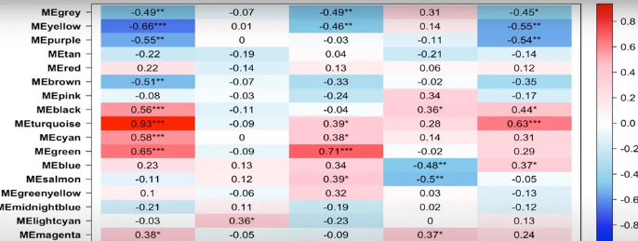
RESULTS
13
MOLECULAR BIOLOGY AND BASIC CELLULAR PHYSIOLOGY
HEATMAP FOR GENE MODULES

Slide 14
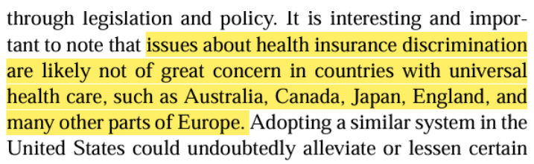
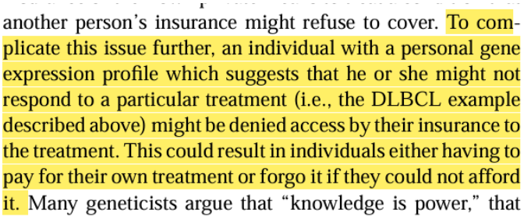
14
Gene expression and measurement technologies: innovations and ethical considerations, 2003
Key issues discussed:
Employers, insurance companies may misuse genetic data. Risk of denial of jobs due to gene expression profiles more
Hight cost and therefore, unequal access to treatments based on financial status.
Proposed solutions:
Laws should be made to prevent discrimination and ensure fair access to healthcare.
Scientists and engineers need to discuss and implement ethical guidelines.
ETHICS

Slide 15
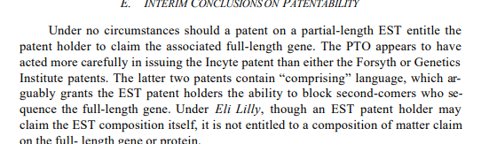
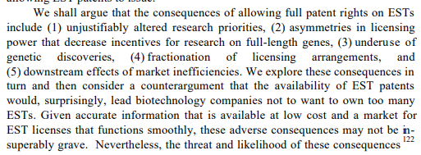
INTELECTUAL PROPERTY RIGHTS
15
Intellectual Property Rights in Genes and Gene Fragments: A Registration Solution for Expressed Sequence Tags, 2000
The study critiques current patent system. The authors proposed that a registration-based system for the same.
Key points discussed:
ESTs, as small gene fragments have made many legal controversies over patentability.
Traditionally patenting of ESTs have lead to monopolization and limited accessibility.
The study further discusses whether genetic information should be considered public knowledge rather than private property.

Slide 16
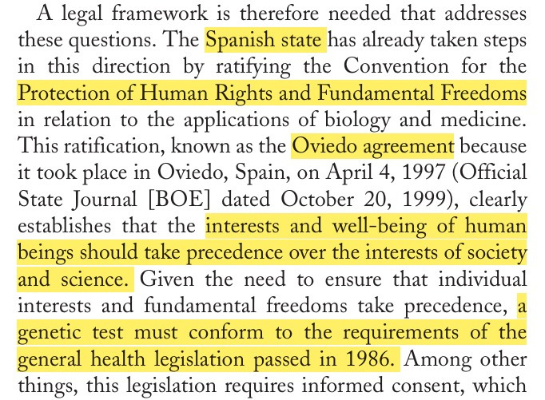
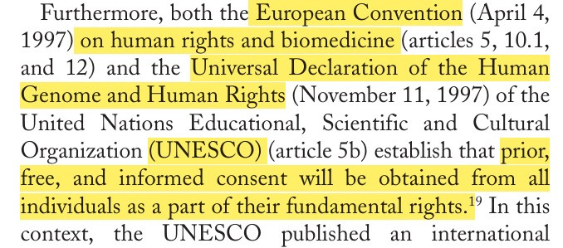
INNOVATIVE RESEARCH
16
Pharmacogenetics II. Research Molecular Methods, Bioinformatics and Ethical Concerns, 2006
Key points discussed:
Ethical concern - access to genetic information and its usage
Spain has ratified the Oviedo Agreement (1997) for human rights in biology and medicine.
Required consent before conducting genetic tests.
Genetic data belongs to the individual and not public or private entities !
Data protection laws by Spain’s Organic Law 15/1999 which prevents all personal data along with genetic data

Slide 17
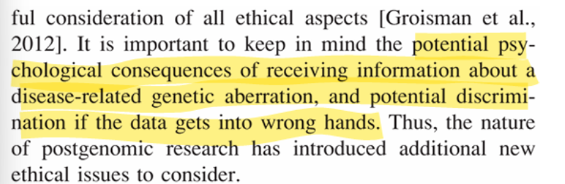
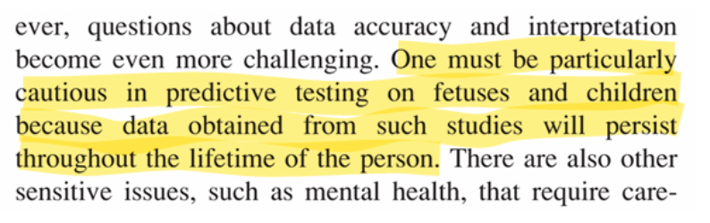
ETHICS
17
Research Ethics in the Post-Genomic Era, 2011
Key points discussed:
Ethical concern - focuses on obtaining proper informed consent from the participants and ensuring information remains private.
Researchers need to balance for open data sharing with respecting individual's control over their genetic data.
Ethical guidelines should be in favor of progress for scientific and participant protection.

Slide 18
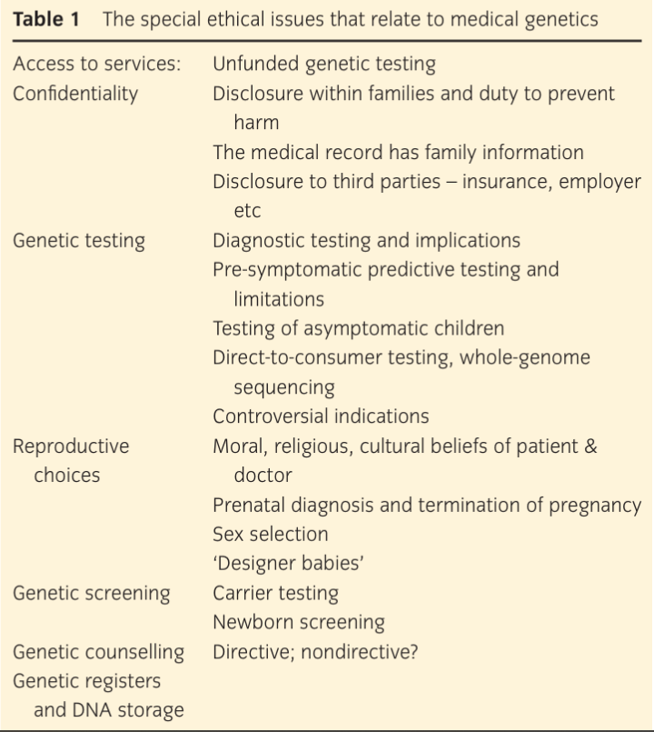
ETHICS
18
Ethical Issues in Genetics, 2011
Key points discussed:
Ethical dilemma - around fairness (justice), autonomy (right to choose), beneficence (doing good) and non-maleficence (avoiding harm).
Genetic testing expensive and not covered by insurance most of the time.
Confidentiality is crucial and doctors need to warn family about hereditary risks.
Whole genome sequencing soon will become the norm and need new ethical guidelines.
Ethical concerns on selecting embryos for specific traits
Sex selection - increasingly common in some countries leading to imbalance.

Slide 19
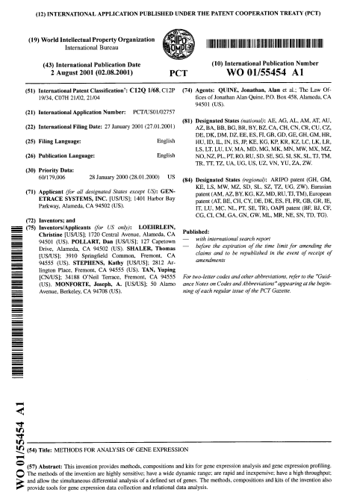
19
PATENT
FROM THE WORLD INTELLUCTUAL PROPERTY ORGANIZATION,
TITLE OF PATENT: METHODS FOR ANALYSIS OF GENE EXPRESSION, 2001
PATENTED BY: GENTRACE SYSTEMS, INC (US), ALAMEDA, CA
CLAIMS OF THE PATENT:
The novel sequencing technique used for gene analysis.
A proprietary algorithm for analyzing gene expression data
The integration of AI or bioinformatics tools in the analysis.
Any specialized reagents or lab equipment involved.
METHODLOGY:
Microarray technology, RNA sequencing, Quantitative PCR, computational modeling and bioinformatics.
Analytical frameworks and potential machine learning model.

Slide 20

20
TIMELINE
WEEK 1-4 : Completed weighted co-expression gene network and analysis for COVID-19.
WEEK 4-6: Perform enrichment analysis for the same and infer results.
WEEK 7-8: Construct co-expression gene network for another similar disease and integration of AI.
WEEK 9-10: Compare both the results
WEEK 11-12: Infer ethics, intellectual property rights and patent along the way for the same

Slide 21
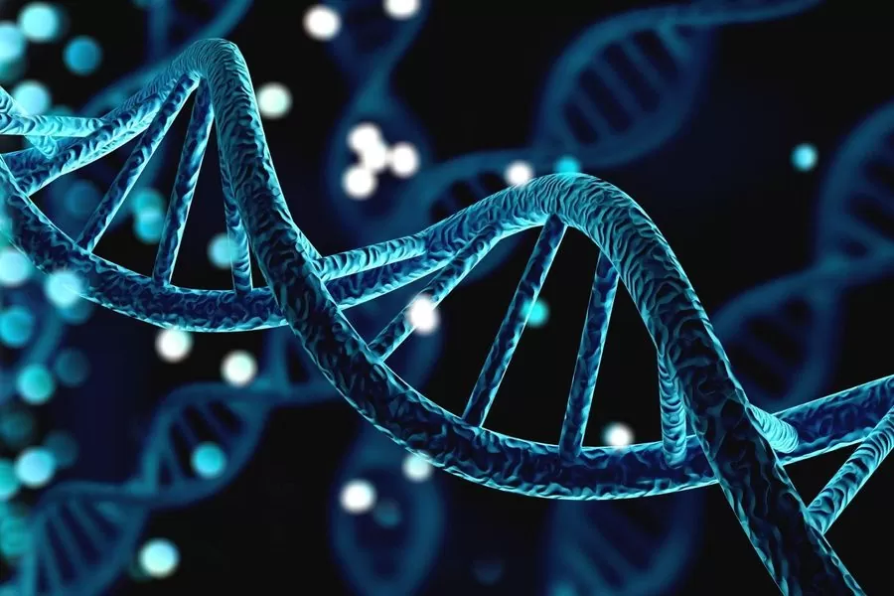
REFERENCES
21
Weighted gene co-expression network analysis combined with machine learning validation to identify key modules and hub genes associated with SARA-CoV-2-Infection, 2021
Drug repurposing for coronavirus (SARS-CoV-2) based on gene co-expression network analysis, 2021
Differential Co-expression network analysis reveals key Hub-High traffic genes as potential therapeutic targets for COVID-19 pandemic, 2021
Weighted gene co-expression network analysis to identify potential biological processes and key genes in COVID-19 related stroke, 2022
Intellectual Property rights in genes and gene fragments: A registration solution for expressed sequence tags, 2000
Methods for analysis of gene expression, World Intellectual Property Organization, 2001

Slide 22
Thank you

